Slide 1
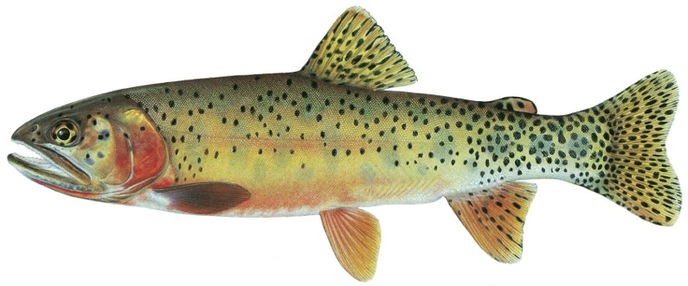
Returning Native Trout to Texas?
Update & Next Steps
GRTU – April 2015

Slide 2
What Got it All Started:
“Rio Grande Cutthroat Trout in Texas” by Gary Garrett and Gary Matlock, Texas Journal of Science, 1991
Anecdotal evidence of sightings of trout in Texas streams
Garrett and Matlock thoroughly researched historical and scientific records and concluded that RGCT in TX a strong possibility
I met Dr. Garrett at a meeting in Kerrville in 2005, began discussing the possibility of reintroducing RGCT to McKittrick Canyon, and so began the adventure

Slide 3
History of Trout in Texas
Trout were likely Texas natives
Described by explorers who named the Guadalupe
Rio Grande Cutthroat found in West Texas in 1800s
McKittrick Creek in Guadalupe Mountains
Limpia Creek in Davis Mountains
Bucket biologists descend
Rainbows stocked in McKittrick Creek in 1917, the 1920s and the 1940s ( the only current wild trout population in Texas)

Slide 4
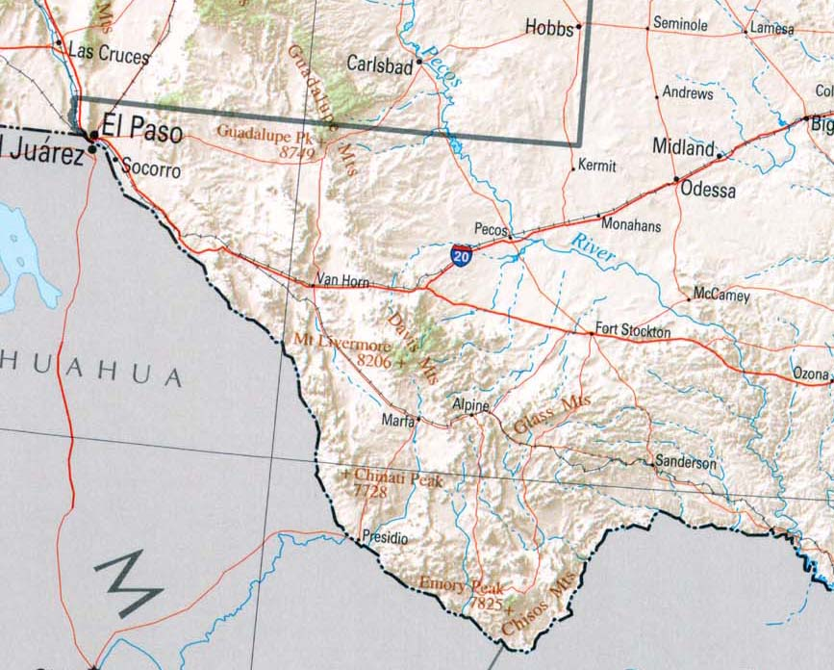
Native Trout Locations in Texas

Slide 5
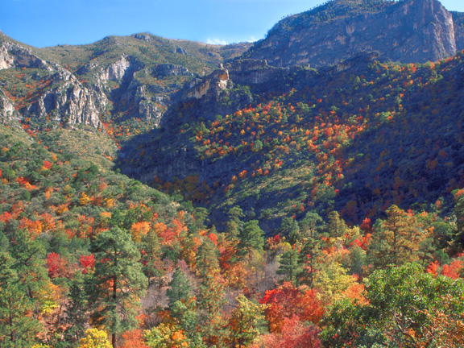
McKittrick Canyon

Slide 6
What Does Trout Unlimited’s Science Research Tell Us?

Slide 7
What will the future be like for trout and salmon in the West?
Increasing demand for fresh water supplies
Increasing push for energy development
Increasingly warm and dry with larger storms and wildfires
More invasive species
And, more uncertainty as these factors combine

Slide 8
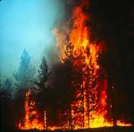
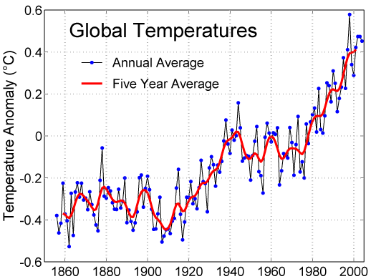
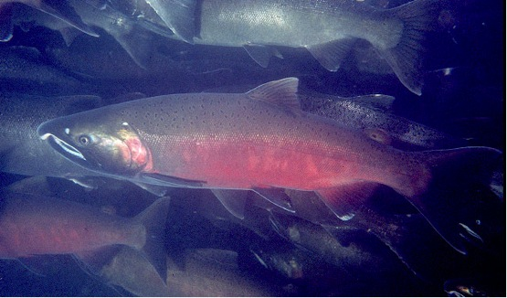
How do we cope with a warmer and less certain future?
1. Save all the pieces – maximize diversity
2. Increase the resilience of our populations and habitats
3. Spread the risk

Slide 9
What are the Key Factors in Saving a Species?
Representation:
Is there genetic integrity?
Is there life history diversity?
Is there geographic diversity?
Resiliency:
How stable and strong are the populations?
Redundancy:
How many populations are there?

Slide 10
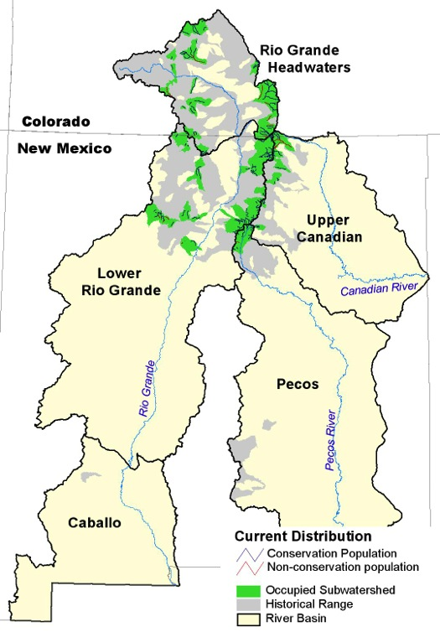
Balancing the portfolio of
Rio Grande cutthroat trout
Basin | Total Number of Pops. | Occupied Stream Habitat (Km) | Representation (number of pops.) |  |  | Resilient (number of pops.) | Redundant (number of pops.)
 |  |  | Genetic Integrity | Life Hist. Diversity | Geographic Diversity
Rio Grande Headwaters | 40 | 466 | 36 | 3 | NA | 1 | 10
Lower Rio Grande | 58 | 489 | 37 | 1 | 8 | 0 | 12
Upper Canadian | 12 | 109 | 9 | 0 | NA | 0 | 1
Pecos | 11 | 60 | 7 | 0 | 0 | 0 | 1
Total | 121 | 1124 | 89 | 4 | 8 | 1 | 24

Slide 11
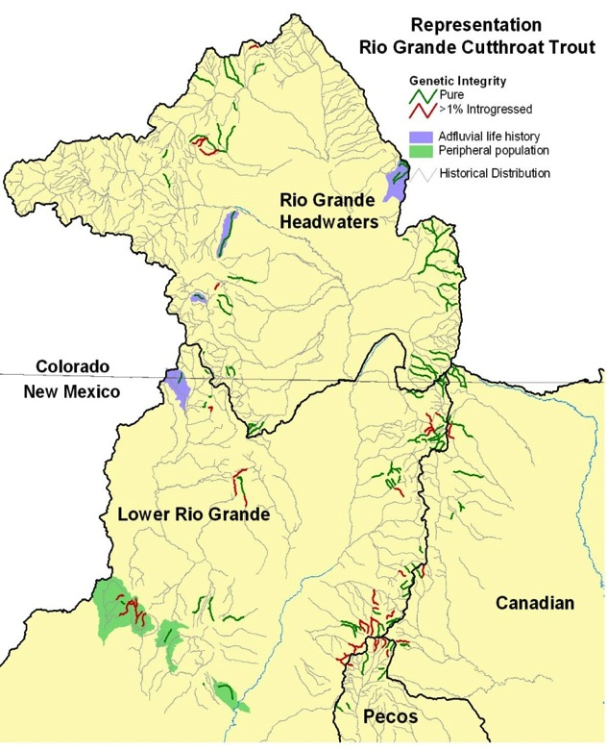
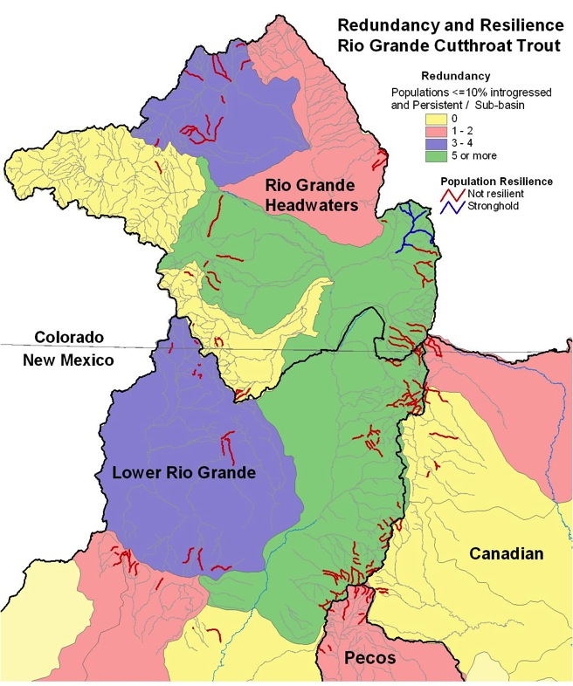
Applying the 3-R Framework – Spatial Results
Spatially explicit analysis allows for the development of place-based projects linked to specific rangewide conservation objectives.

Slide 12
What does the portfolio for RGCT tell us about conservation opportunities and strategies?
Representation: genetic integrity well protected
Representation: life history diversity poorly represented
Representation: geographic diversity, extirpated from Texas and southern New Mexico basins
Resiliency: lack of large inter-connected stronghold populations
Redundancy: good scores in Rio Grande basins but poor redundancy in Pecos and Canadian

Slide 13
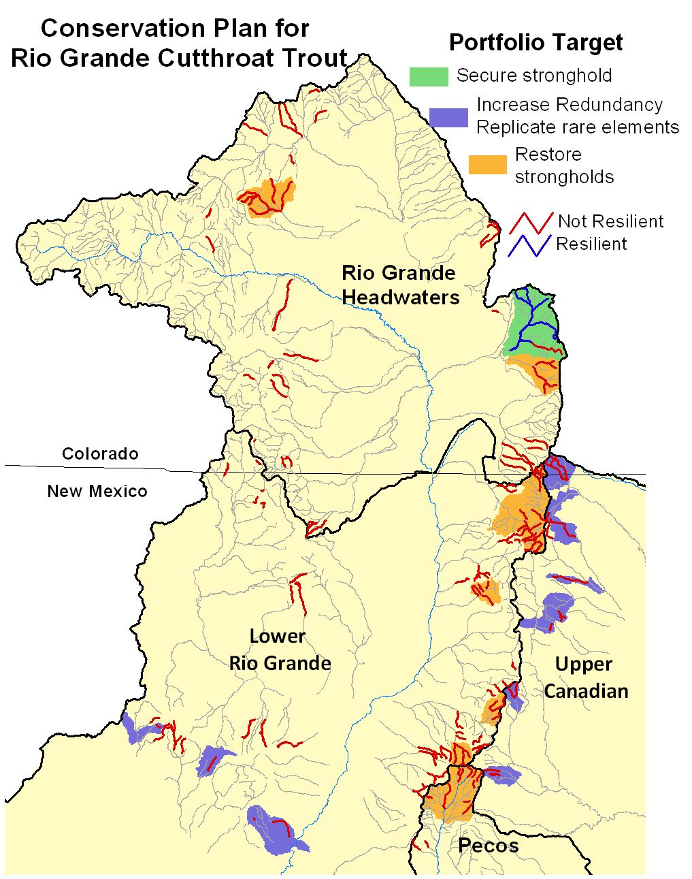
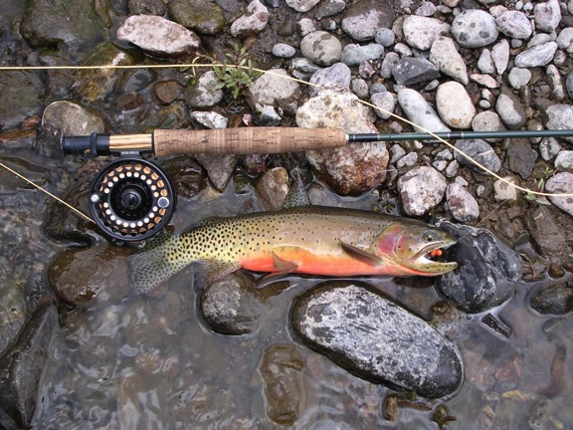
Identify place-based opportunities and targeted conservation strategies for mitigation.

Slide 14
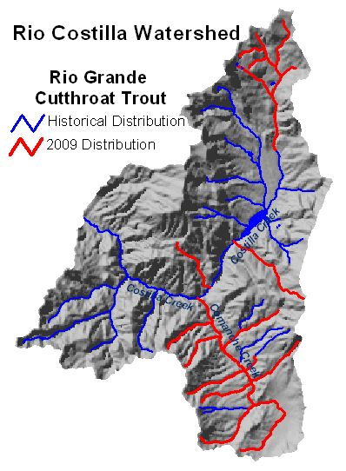
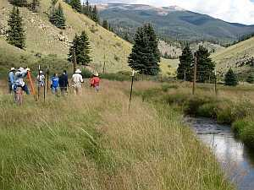
Rio Costilla Watershed Restoration Project
240 km of inter-connected stream habitat
25 lakes
Genetically pure RGCT
Restore entire native fish species assemblage.

Slide 15
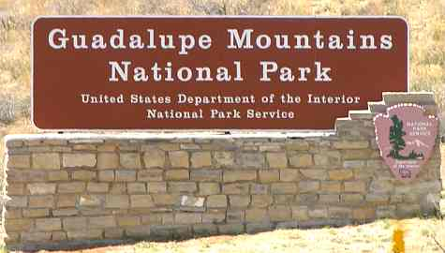
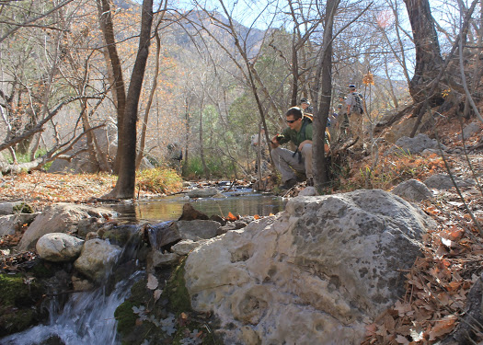
Emphasizes importance of McKittrick Creek reintroduction effort to increase redundancy in Pecos drainage

Slide 16
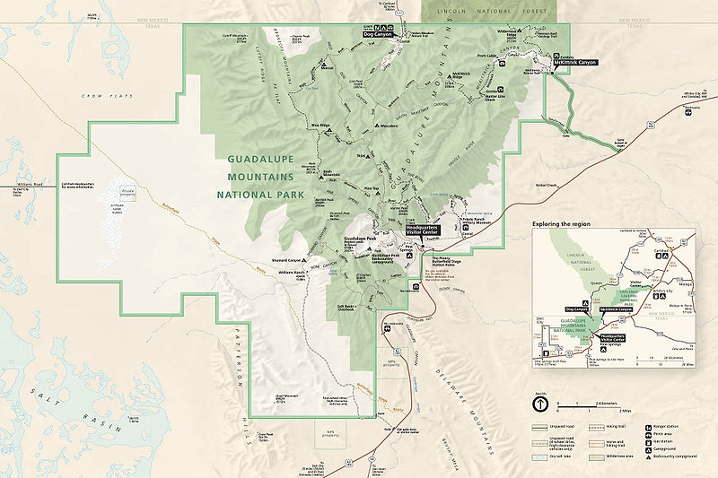
Guadalupe Mountains National Park

Slide 17
What’s Happened So Far
Team including TU, GRTU, NPS, TPWD, USFWS, NMDNR, USGS, NMSU, NMTU made two park visits (early 2011, late 2012) and one DC visit to NPS
Local staff agreed to allow study of McKittrick Creek
$42k provided by GRTU(COCF) and TPWD( State Wildlife Grant) in a 35:65 match
Field study conducted by team from NMSU and TPWD
Park staff turning over

Slide 18
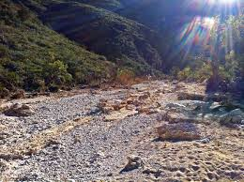
What else happened…
In Mid Sept 2013: a 13.6” of rain fell on McKittrick Canyon in 12 hours; nearest USGS flow gauge jumped from 0>50k cfs
It happened again (to a lesser degree) in September 2014!
What usually looks like this:

Slide 19
Looked like this:
https://www.youtube.com/watch?feature=player_detailpage&v=xen0Pjz4f14

Slide 20
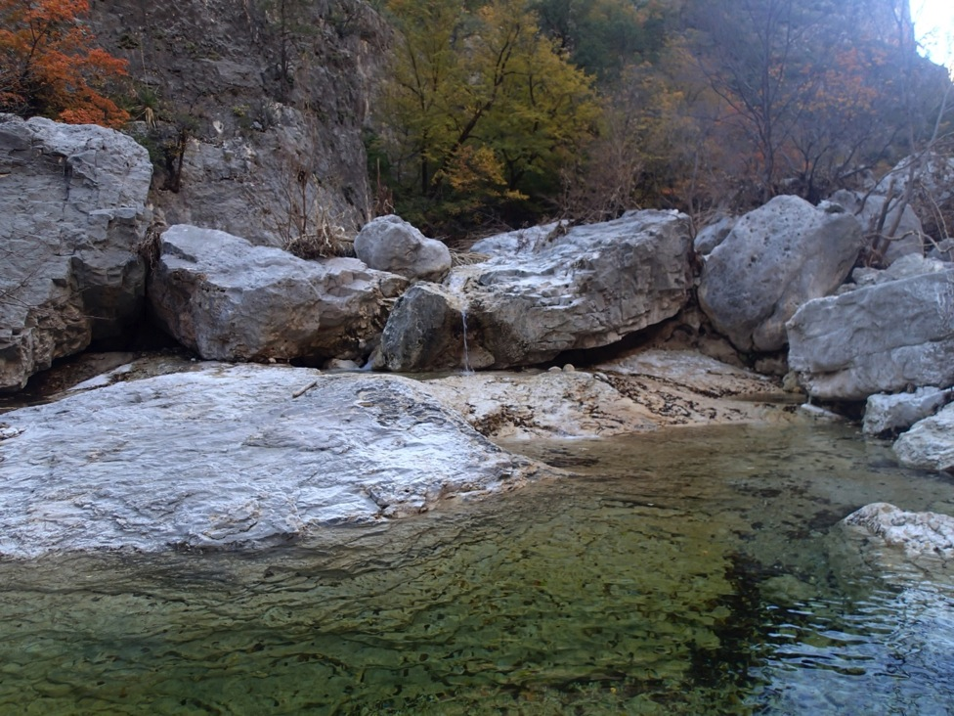
Feasibility Study: Re-establishing Native Fish Fauna to McKittrick Creek, Guadalupe Mountains National Park, Texas
Interim Report
October 2014
Prepared for Guadalupe Mountains National Park
by
New Mexico State University
Texas Parks and Wildlife Department
Notes:
Cover page of the report
We returned to GUMO June 2015 to locate the data loggers, but these were lost due to a second 400 year flood in the canyon. We re-deployed new loggers for retrieval at the end of summer 2015.
Final report will have all the figures you see here and the temperature data.

Slide 21
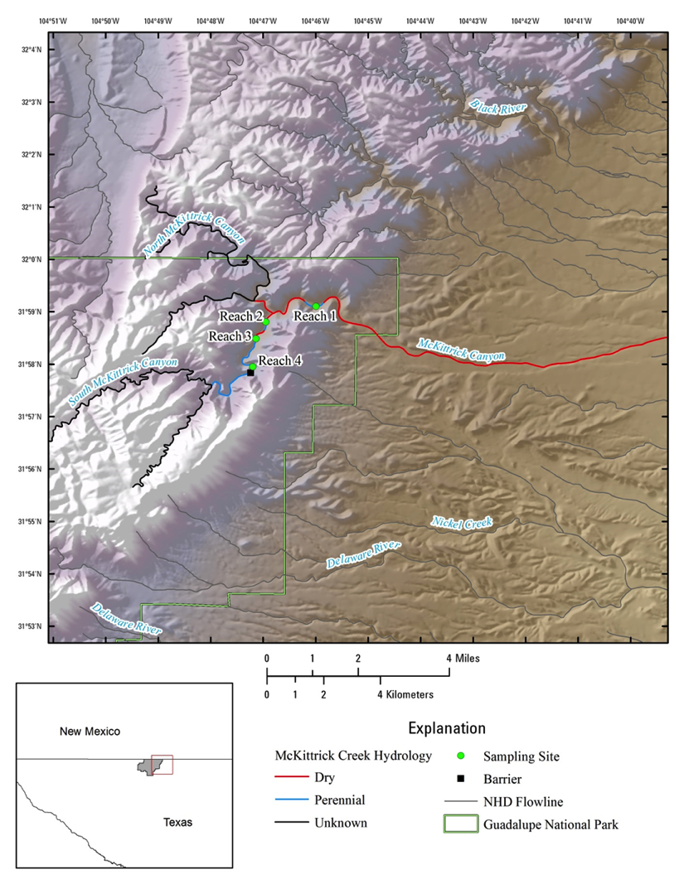
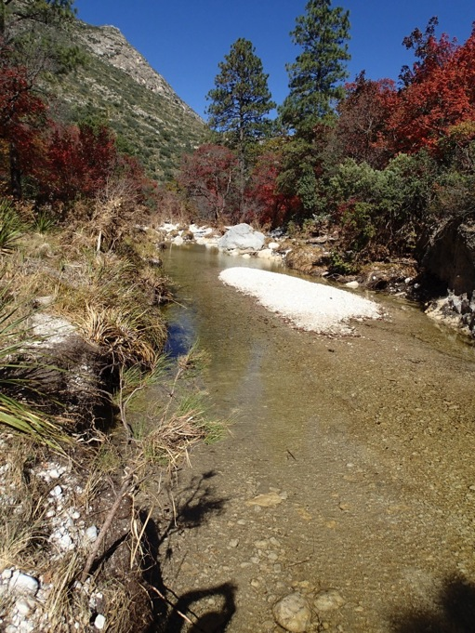
Study Area of McKittrick
Creek
Depicts perennial water reaches &
sample sites
Notes:
- Map of McKittrick creek with locations of sampling reaches and perennial/dry stream areas: the blue line depicting perennial water might be too small to see…suggest that you point to it. Same for sample sites (green dots)

Slide 22
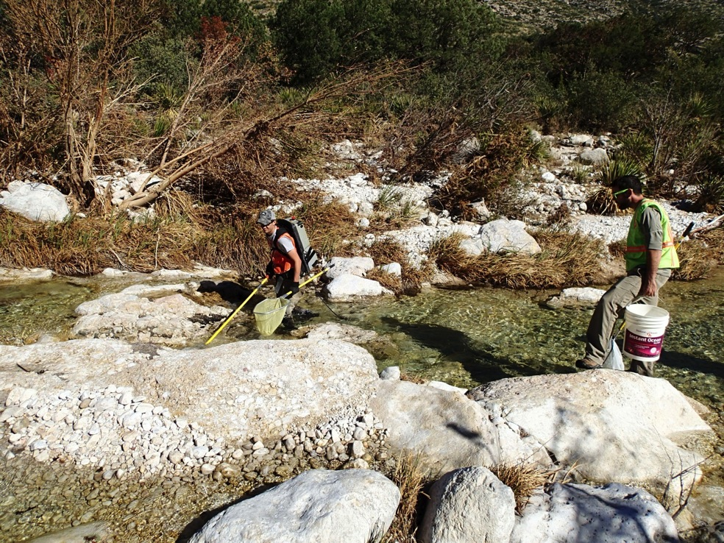
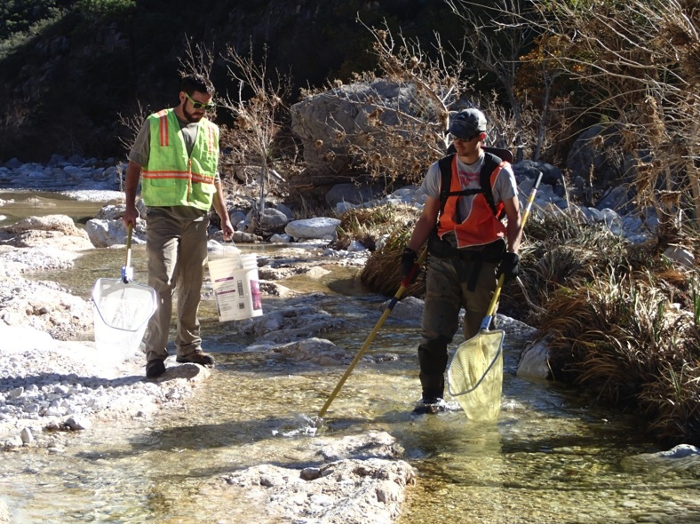
Reach 1
Craig Townsend & Matt Ziegler electrofishing

Slide 23
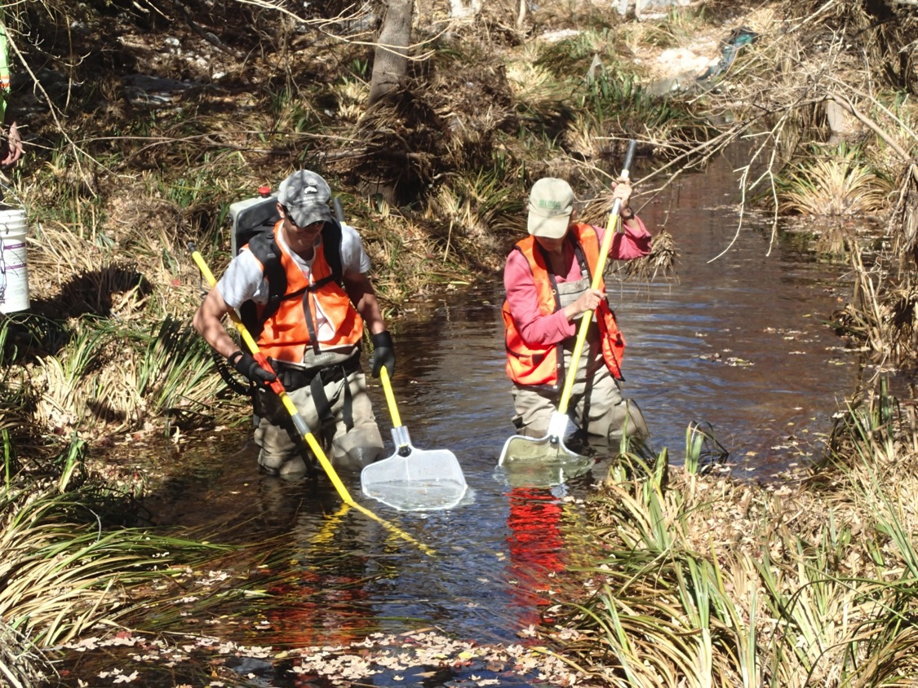
Reach 2
Matthew and Colleen electrofishing in Reach 2 of McKittrick

Slide 24
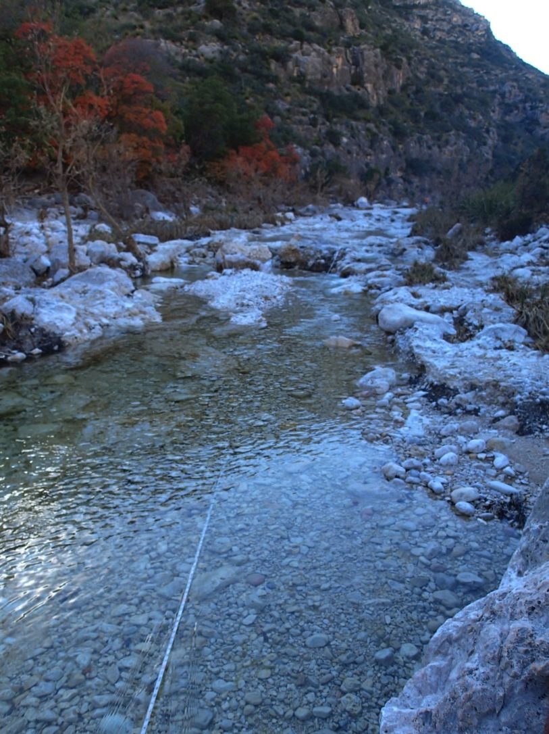
Reach 3

Slide 25
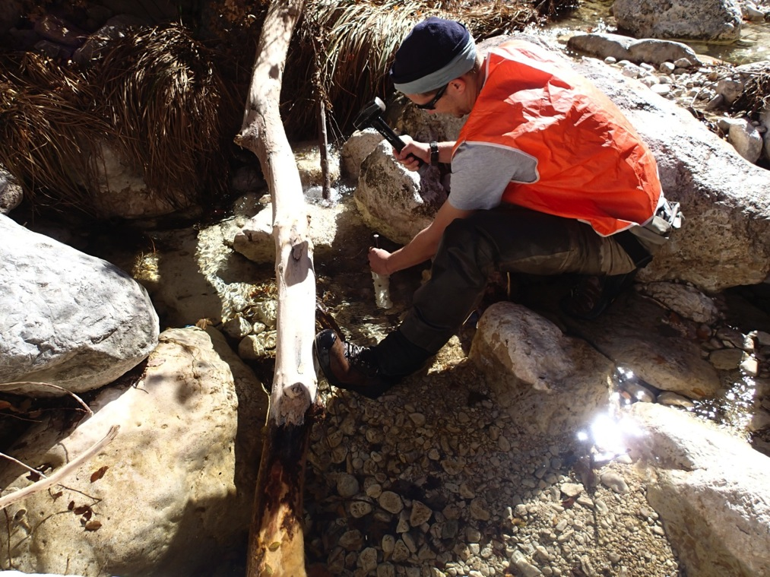
Matthew setting in a Temperature datalogger

Slide 26
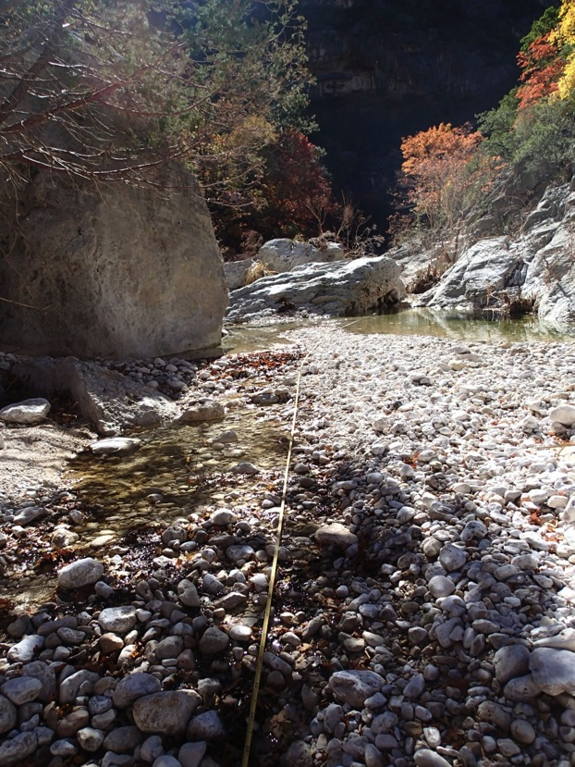
Reach 4

Slide 27
McKittrick Study Areas
Reaches | Length | Width | Elevation | Trout | Sunfish
1 | 300’ | 14’ | 5100’ | 24 | 0
2 | 253’ | 6’ | 5250’ | 13 | 8
3 | 341’ | 15’ | 5300’ | 3 | 5
4 | 272’ | 9’ | 5400’ | 2 | 0

Slide 28
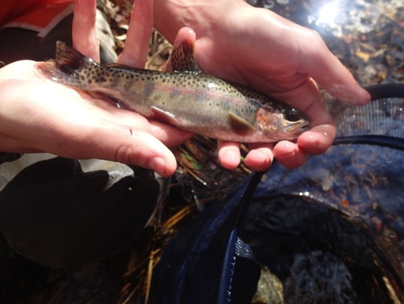
Rainbow trout population estimates
 | Population estimate (fish/100 m²)
Site | Fall 2013 | Spring 2014 | Fall 2014
Reach 1 | 5.5 (5.2-5.7) | 28.1 (27.0-29.2) | 11.3 (11.2-11.5)
Reach 2 | 7.7 (7.6-7.8) | 17.4 (15.4-19.3) | 8.8 (8.6-9.0)
Reach 3 | 0.6 | 0.2 | 3.6
Reach 4 | 0.9 | 0.4 | 4.8 (4.3-5.2)
Notes:
Table on left reports population estimates of Rainbow trout for each reach and sampling period in fish/100m2; data in parentheses is 95% confidence interval
Graph on right reports average rainbow trout across all reaches per sampling period; bars represent standard error (variation within our sample)
Fish are few at the upper reaches (Reach 3 and 4) ; not sure if this is due to habitat or historic flooding displacing from the upper areas into the lower areas of McKittrick. The larger number of fish in Reach 1 (lowest reach closest to the public trail) Spring 2014 are the young fish. The trout were able to get off a spawn with Reaches 1 and 2 having sufficient habitat to support the juveniles. Not sure where the spawning occurred; perhaps Reach 2 had the best spawning substrate. Will check on this for the final report.

Slide 29
Rainbow trout size structure
Notes:
Length frequency of all Rainbow trout caught in McKittrick Creek during Fall 2013, Spring 2014, and Fall 2014 sampling
Total length category represents 2 cm intervals, so, around 50 fish fell within lengths between 6 and 8 cm
We see fewer smaller fish after the first historic flood in 2013. The larger number of fish (144) in 2014 with the smaller size class indicate these fish got off a spawn in the spring 2014. Note the larger the fish, the fewer there are which is typical of most fish populations. It is hard to make a living as a fish gets larger given the availability of food and habitat.

Slide 30
Rainbow trout body condition
Notes:
Average Relative weight of Rainbow trout in each Total length category for all Fish caught during each sampling period
Bars represent standard error of the mean
Fish in good condition have a relative weight between 90 – 110 shown by the dashed blue lines: data indicates that nearly all fish sampled were in relatively good condition

Slide 31
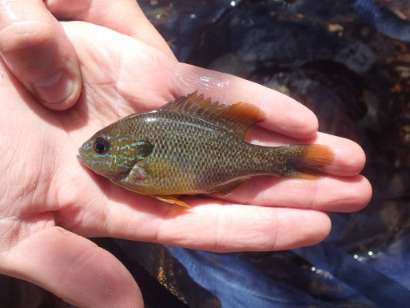
Longear sunfish population estimates
 | Population estimate (fish/100 m²)
Site | Fall 2013 | Spring 2014 | Fall 2014
Reach 1 | 0 | 0 | 0
Reach 2 | 6.5 (4.1-8.9) | 4.6 (4.5-4.7) | 0
Reach 3 | 1.6 (1.5-1.7) | 2.7 (1.7-3.6) | 4.9 (4.5-5.2)
Reach 4 | 0 | 0 | 0
Notes:
Table on left reports population estimates of Longear sunfish for each reach and sampling period in fish/100m2; data in parentheses is 95% CI
Graph on right reports average longear sunfish across all reaches per sampling period; bars represent standard error
Data indicates these fish are only seen in a few reaches that appear to have a bit more complex habitat to offer some cover such as Reaches 2 and 3. Reaches 1 and 2 are wide with a few pools and little no cover for these small fish. We may have lost some sunfish after the second historic flood through the canyon in 2014. The long standard error bars indicate variability when you average in the “0”.

Slide 32
Longear sunfish size structure
Notes:
Length frequency of all Longear sunfish caught in McKittrick Creek during Fall 2013, Spring 2014, and Fall 2014 sampling
Total length category represents 2 cm intervals: 1 fish was collected that was between 2 and 4 cm. 3 fish were collected between 4 and 6 cm, and so on…
Size is a surrogate for age and indicates a population of sunfish that are relatively large and old. It appears that the population was able to get a spawn off after the big flood in 2013. Note very few small fish in Fall 2013 and Spring 2014 samples that appear in Fall 2014 samples.

Slide 33
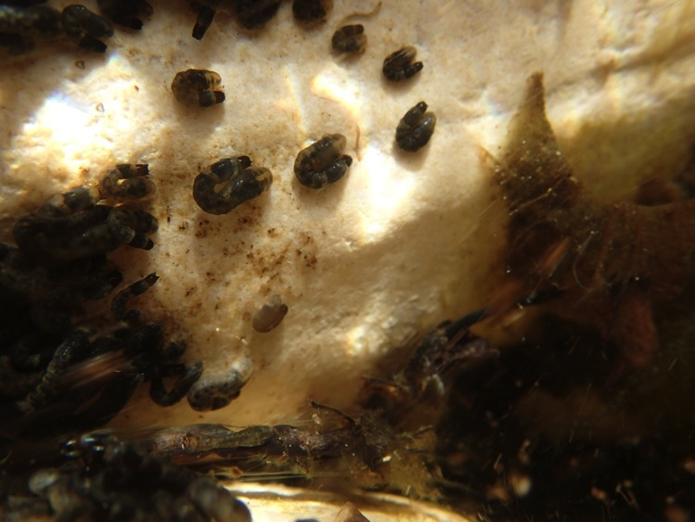
Benthic macroinvertebrate analysis
Benthic invertebrate samples were collected within the same reach as the fish surveys :
Fall 2013 and Spring 2014
Samples are sorted and insects
are being identified to lowest
taxa
Notes:
I shot this photo at McKittrick with my underwater camera. Our first sample collection occurred several months after a historic flood through the Canyon. We noted stream covered with blackfly larvae indicating loads of nutrients were released to the watershed after the flood. Flies are one of the first colonizers into a stream system and take advantage of conditions that might not be supportive of mayfly or stonefly larvae.

Slide 34
Key Factor: Water Temperature
 | Rainbows | RGCT Fry | RGCT Juveniles
Celsius UUILT* | 26.0 | 24.7 | 23.4
Fahrenheit UUILT | 78.8 | 76.5 | 74.1
* Ulitmate Upper Incipient Lethal Temperature

Slide 35
What’s left…
Complete benthic invertebrate analysis (June 2015)
Otolith (fish ear bone) analysis for age structure (June 2015)
Retrieve water temperature loggers (August 2015)
Complete and submit report for review to Trout Unlimited (September 2015)

Slide 36
Acknowledgements
Guadalupe Chapter Trout Unlimited
New Mexico State University – Department of Fish and Wildlife
Matthew Zeigler
Dr. Nicole Harings
Craig Townsend
Will Lubenau
Dominique Lujan
Lindsey McCord
Guillermo Alvarez
Meredith Campbell
Texas Parks and Wildlife
Kenny Saunders
Karim Aziz
Guadalupe Mountain National Park
Janet Coles
Jonena Hearst
U.S. Geological Survey
Dr. Colleen Caldwell

Slide 37
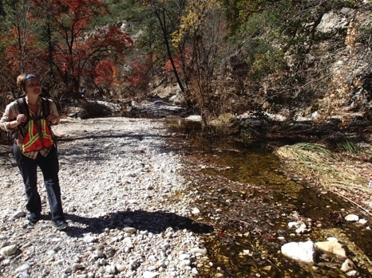
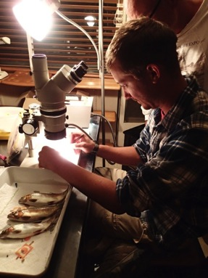
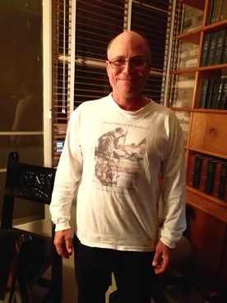
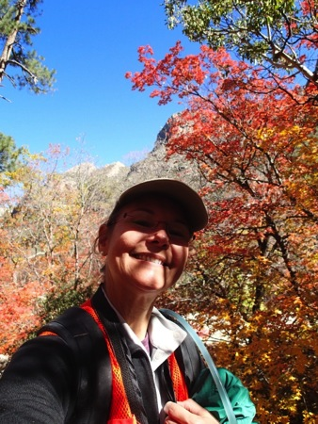
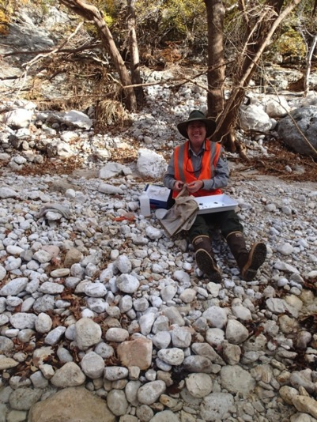
Niki Harings
Matthew Zeigler, NMSU
Kenny Saunders, TP&W
Colleen Caldwell, USGS
Janet Coles, GUMO

Slide 38
Next Steps
Reassemble our team, make another site visit, and introduce our team and project to new Park staff
Seek or authorize funding (COCF, TPWD, EAS)
Install permanent data loggers, including those for stream flow
Compare temperature data to lab results for rainbows and cutthroats
Analyze fin clips for rainbow and cutthroat DNA
Determine whether to prepare the documentation required to switch out rainbows for cutthroats

